Slide 1
Big Data Analytics & Mining

Slide 2
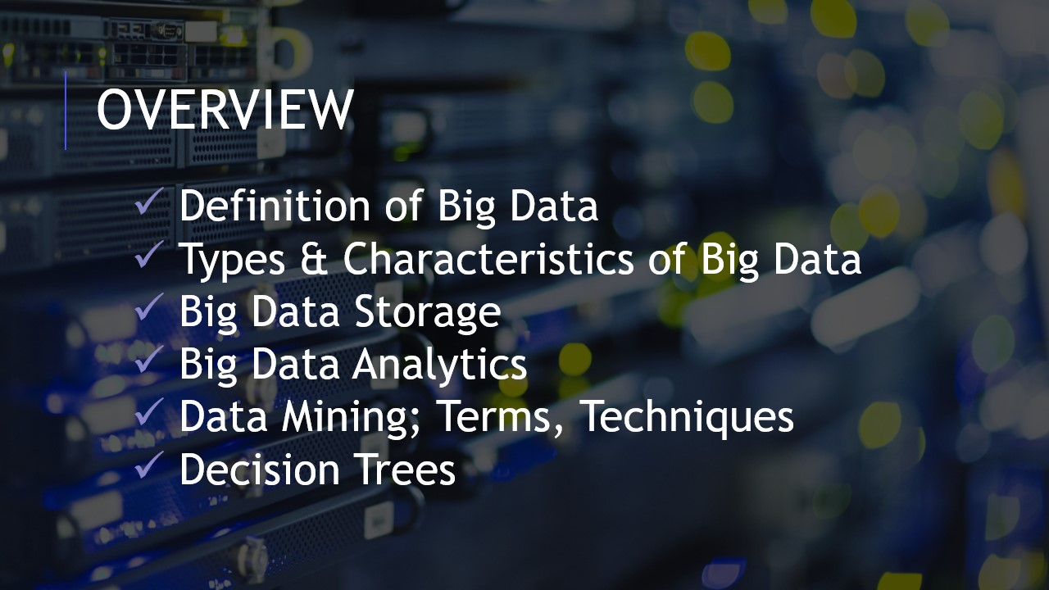

Slide 3
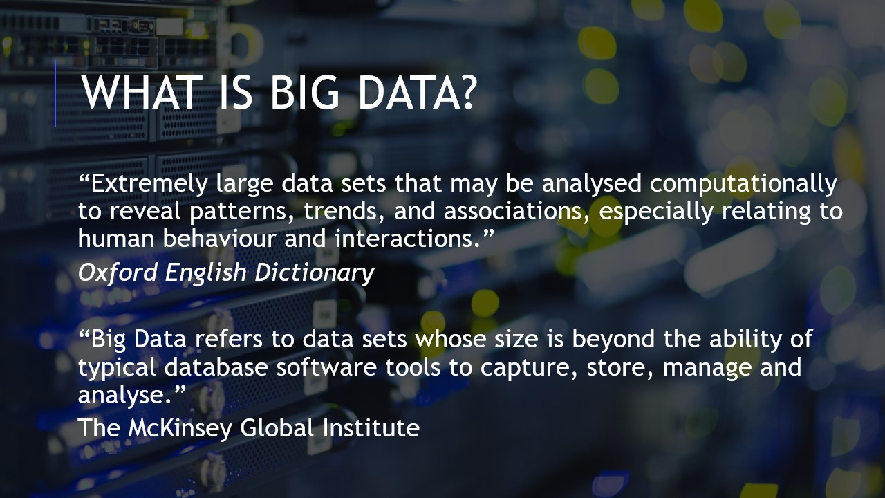

Slide 4
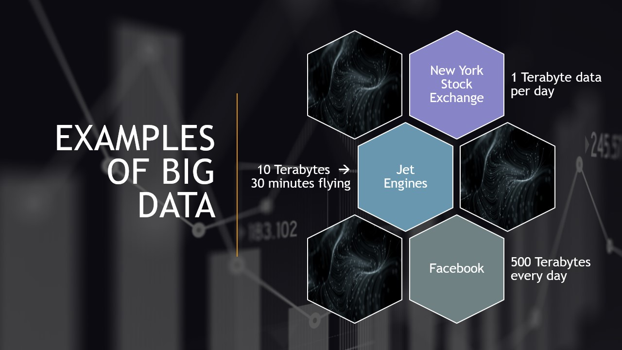

Slide 5
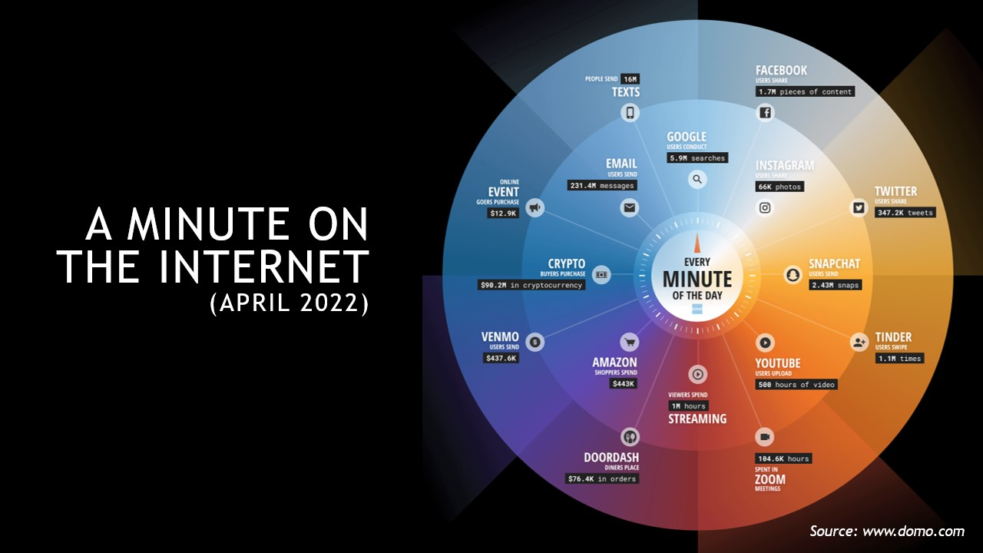

Slide 6
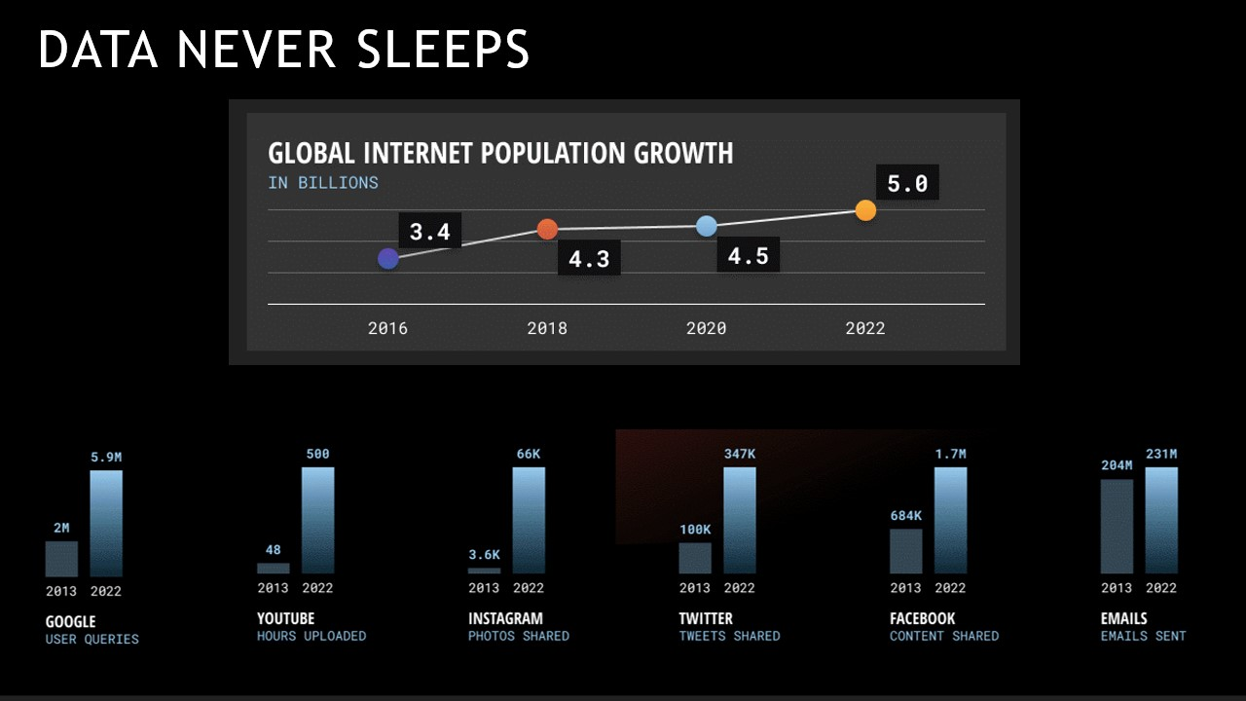

Slide 7
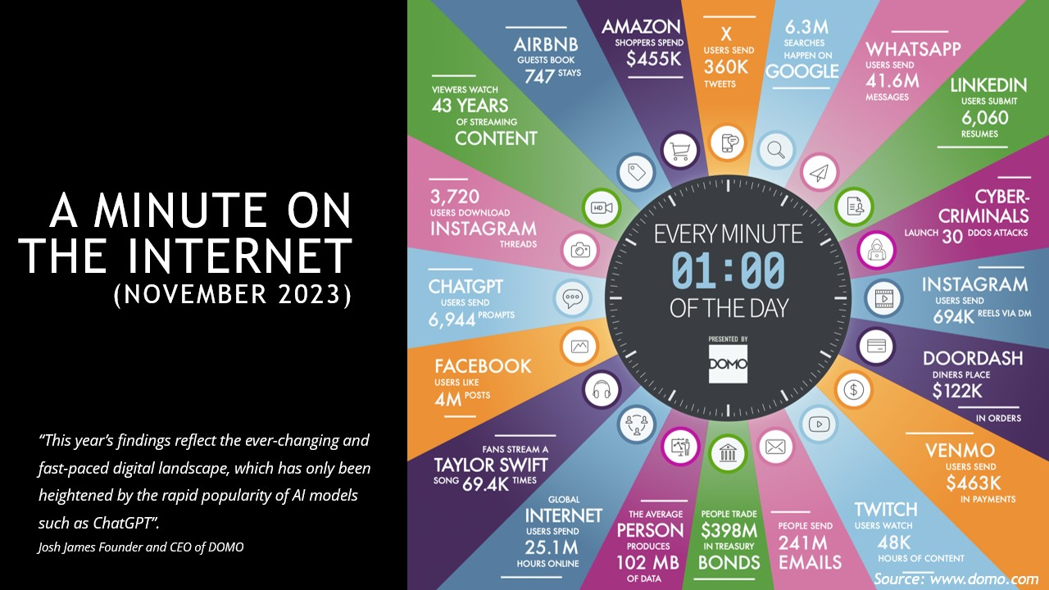

Slide 8
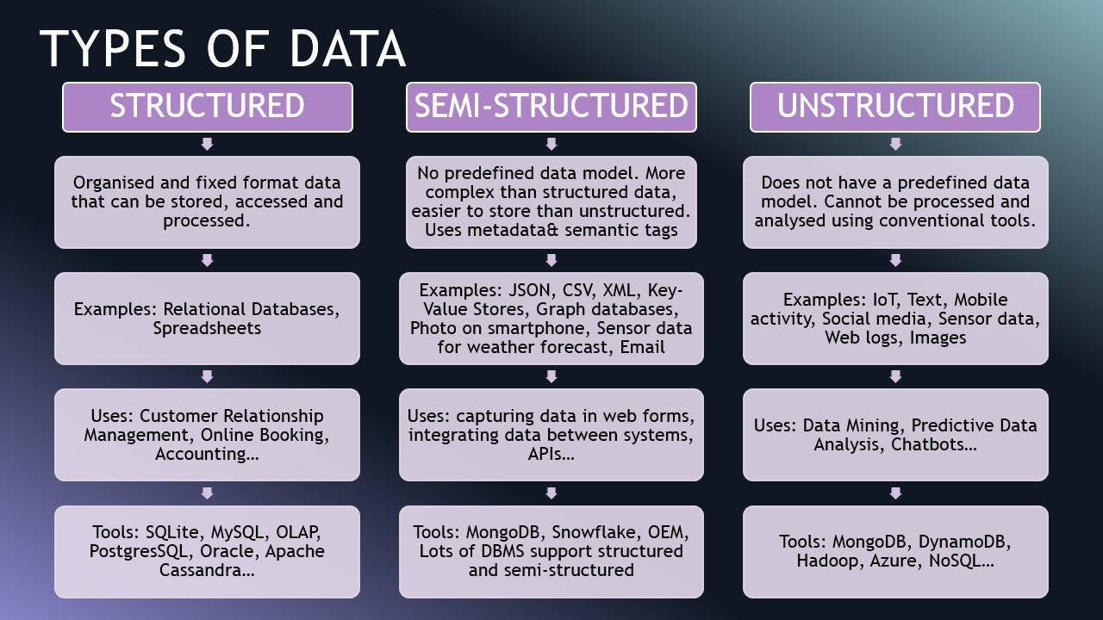

Slide 9
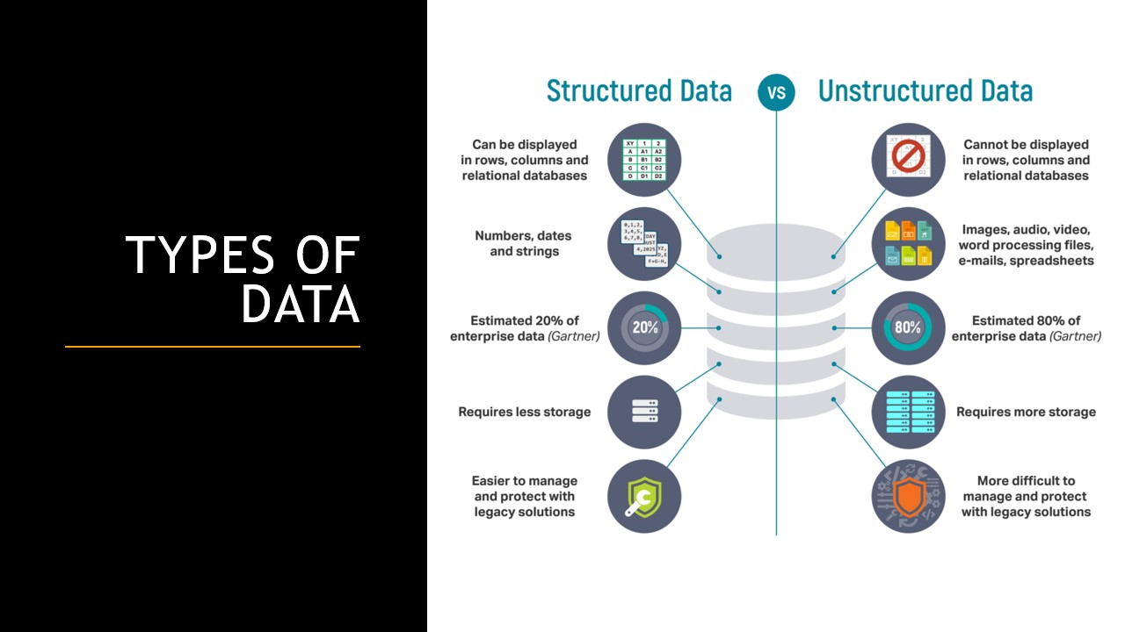

Slide 10
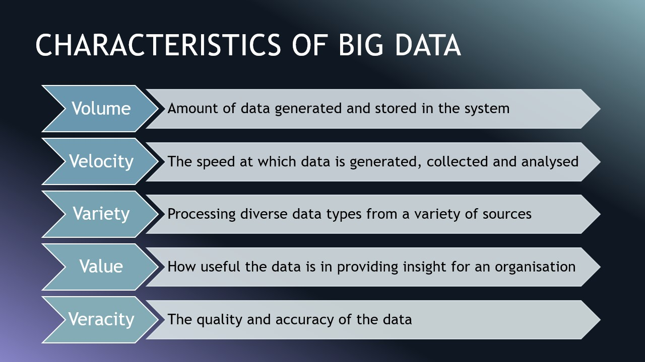

Slide 11
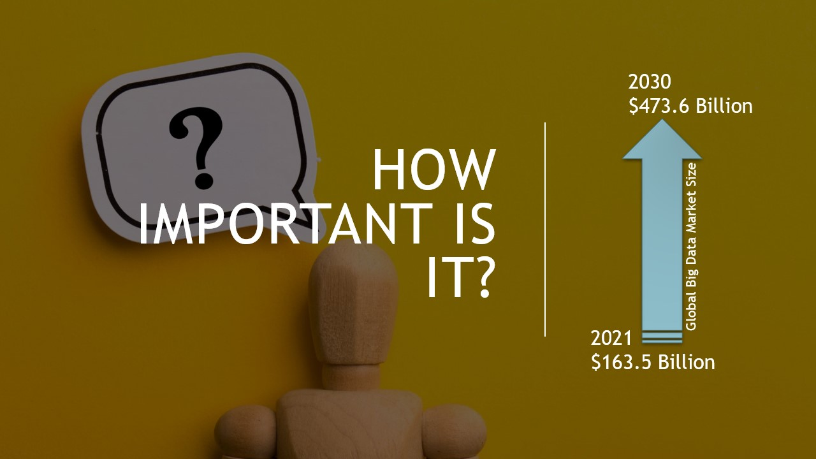

Slide 12
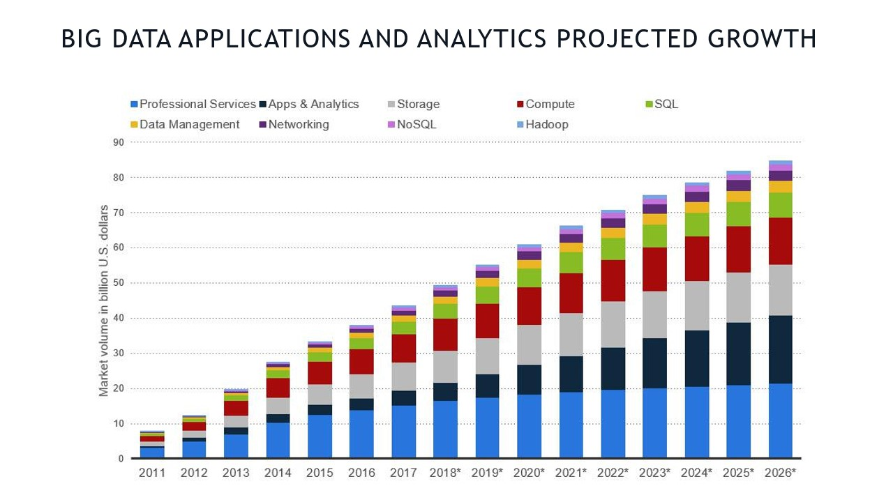

Slide 13
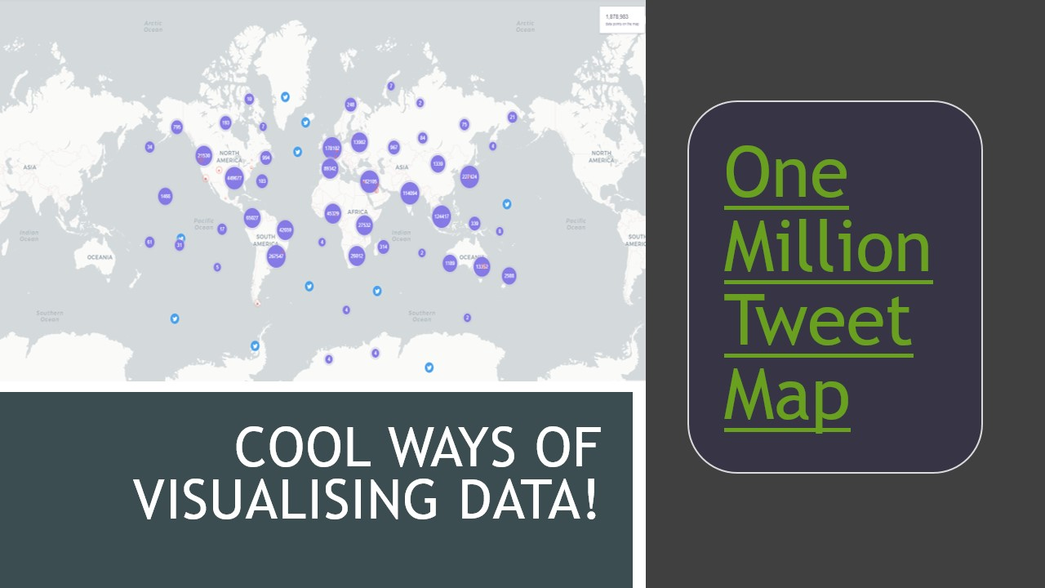

Slide 14
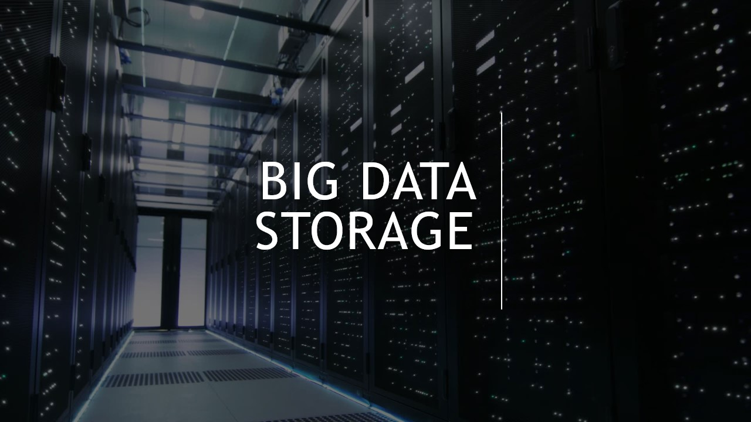

Slide 15
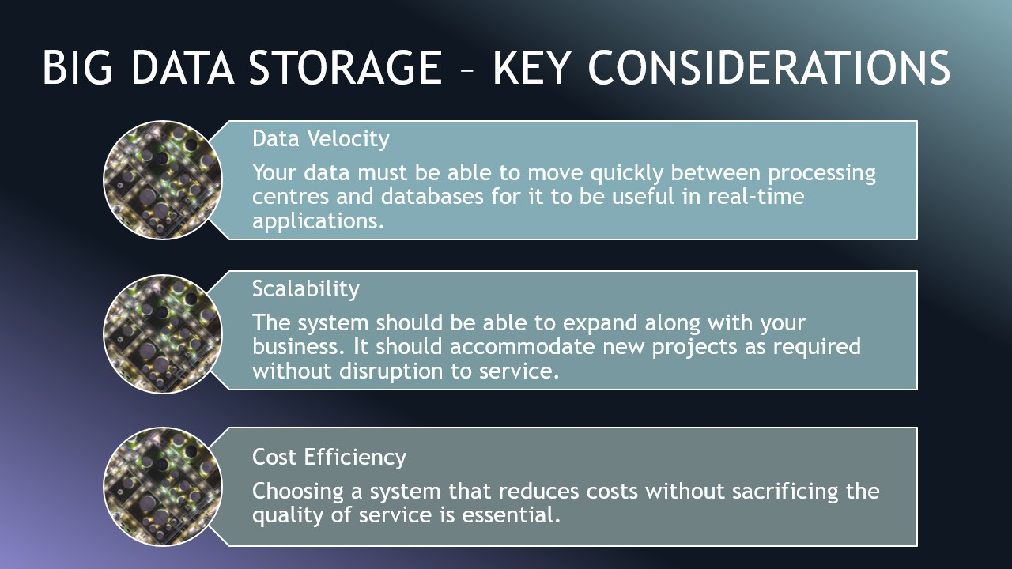

Slide 16
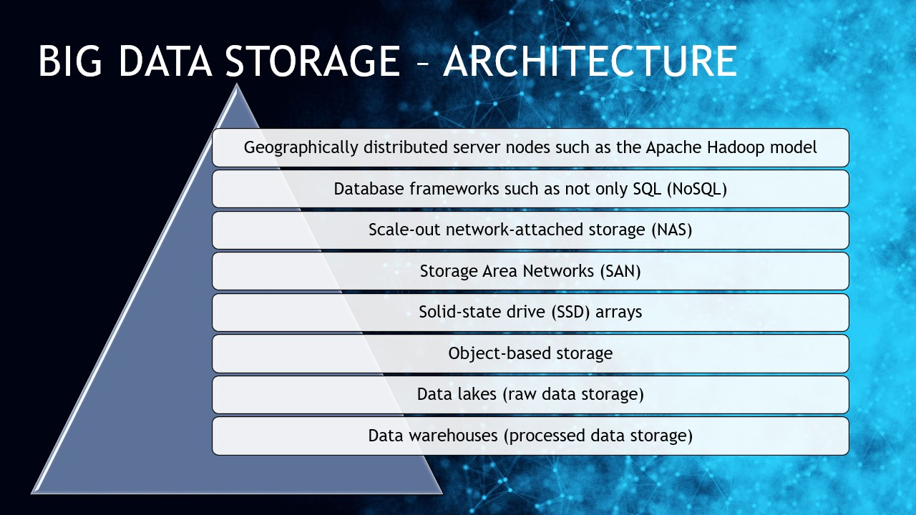

Slide 17
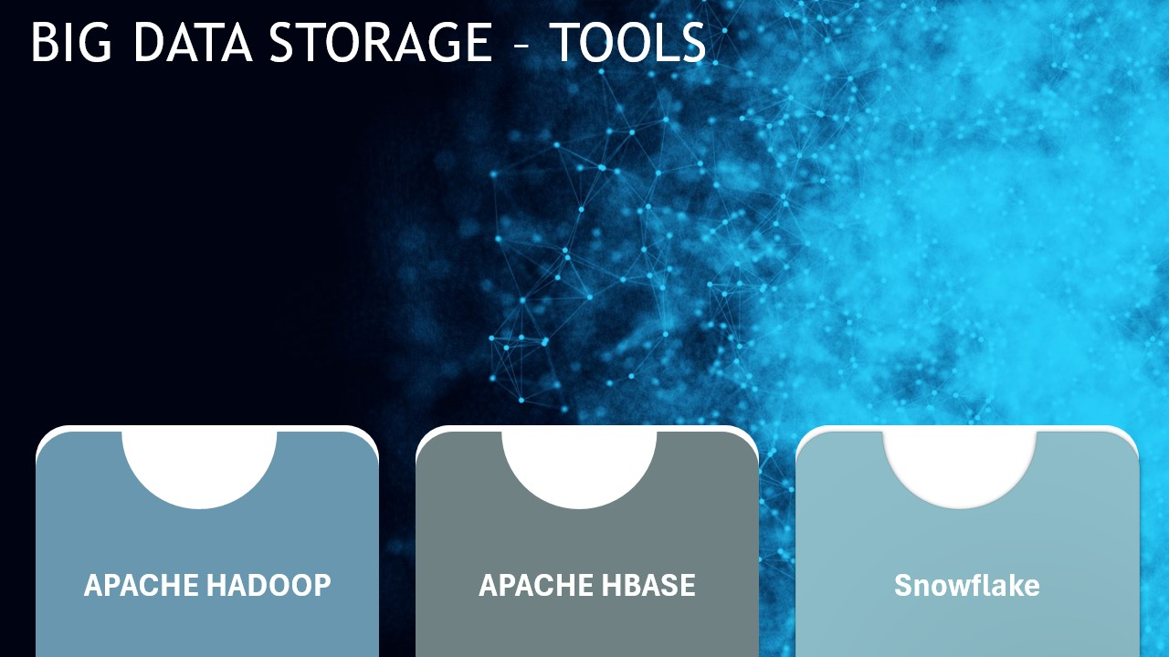

Slide 18
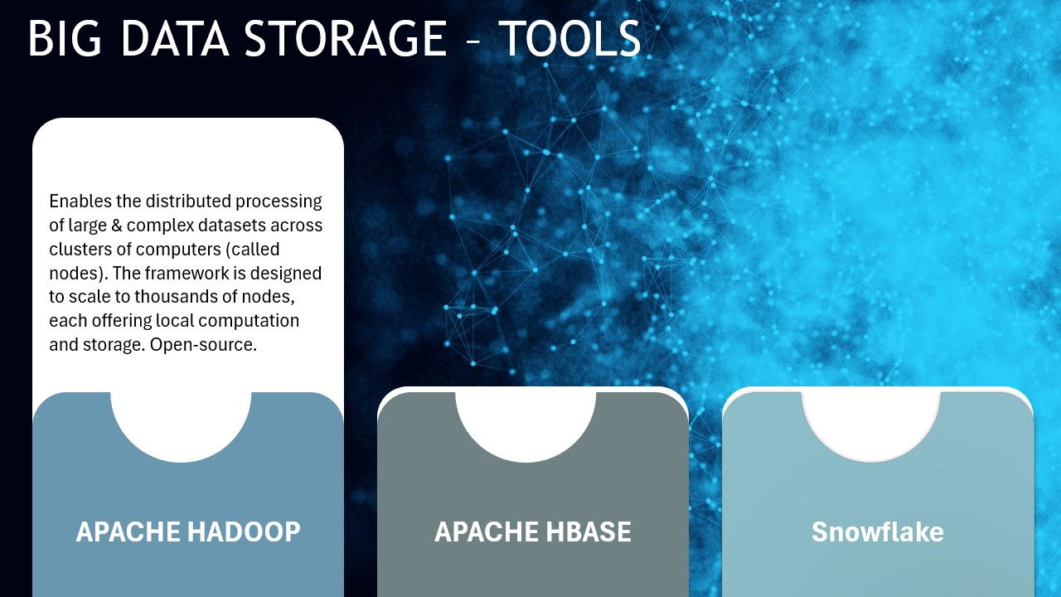

Slide 19
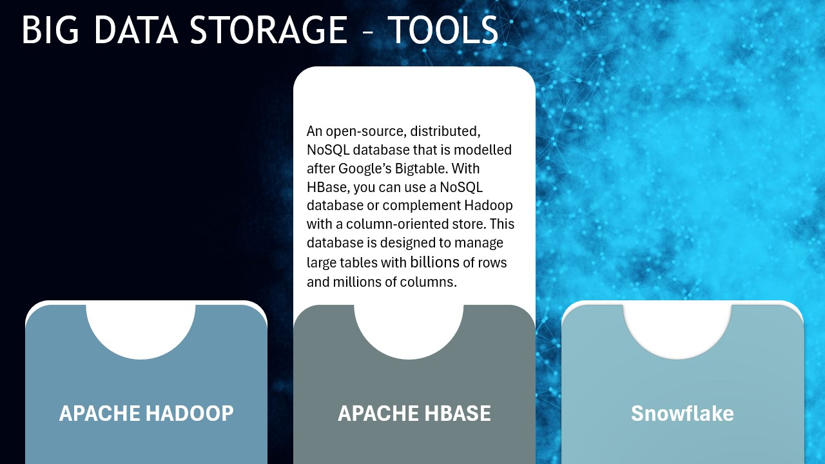

Slide 20
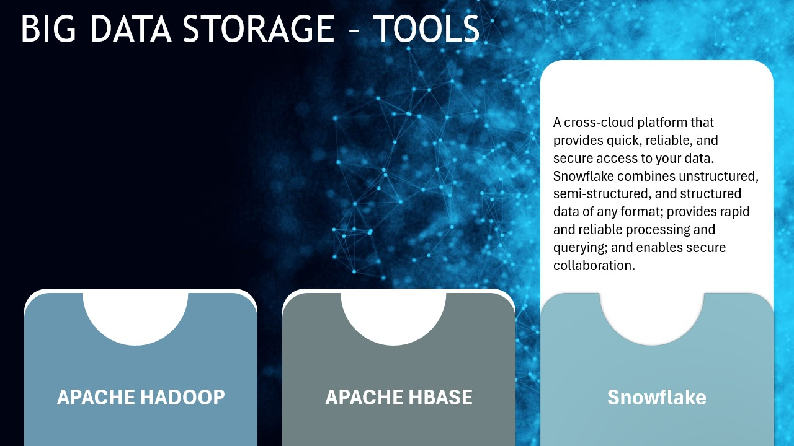

Slide 21
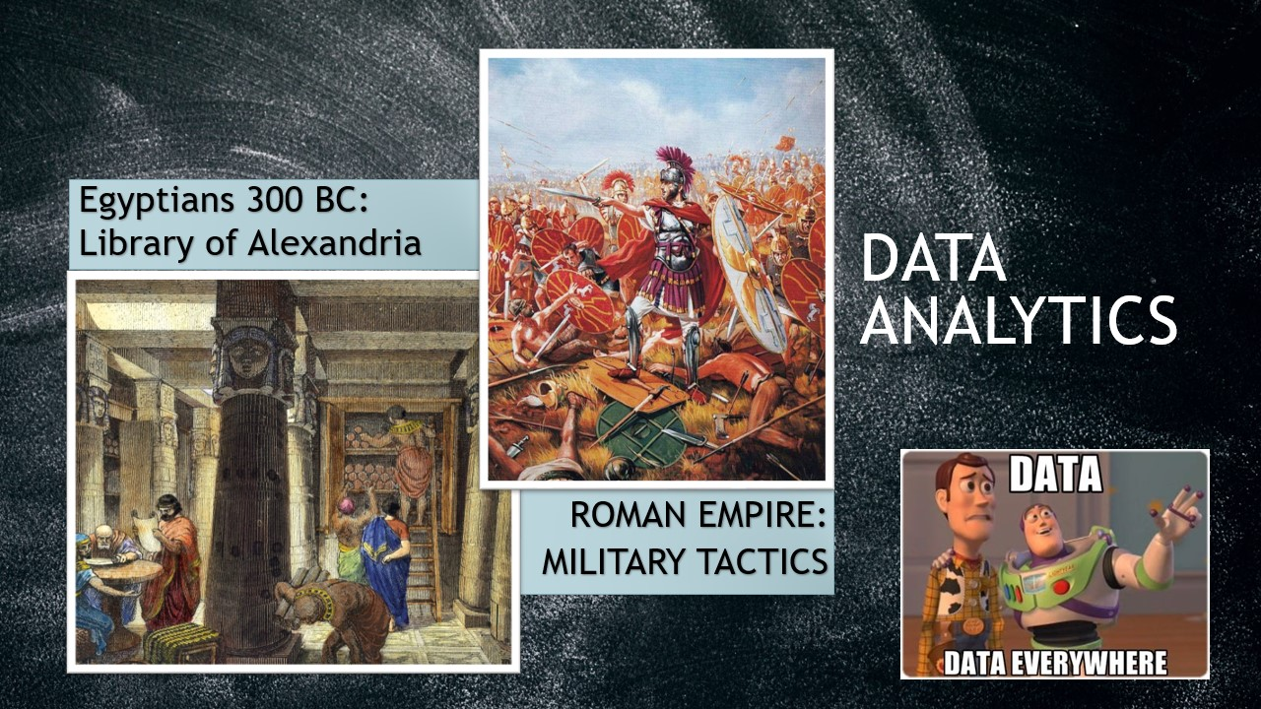

Slide 22
Learning From Previous Experiences

Slide 23
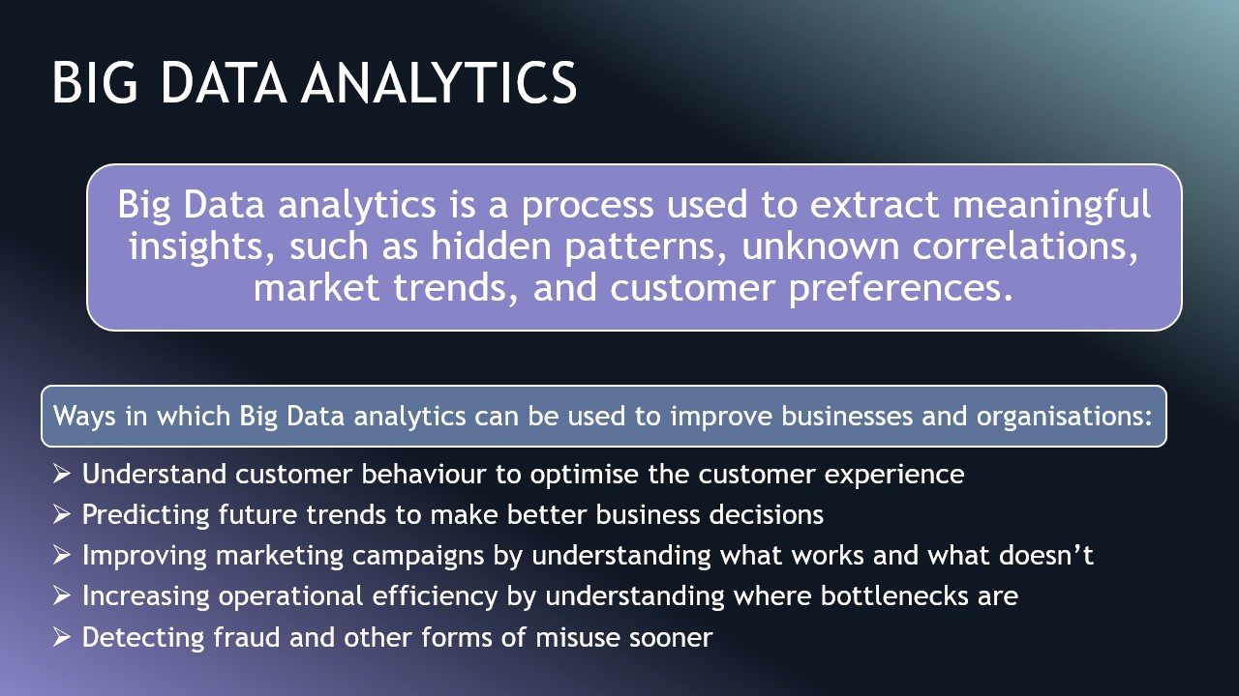

Slide 24
Analytics
Analytics is the process of collecting, analyzing, and interpreting data to discover patterns, trends, and insights that help in making better decisions.
It involves:
Data collection
Cleaning and processing
Finding patterns
Making predictions
Helping decision-making
Analytics can be used in business, healthcare, sports, finance, government, and almost every field.

Slide 25
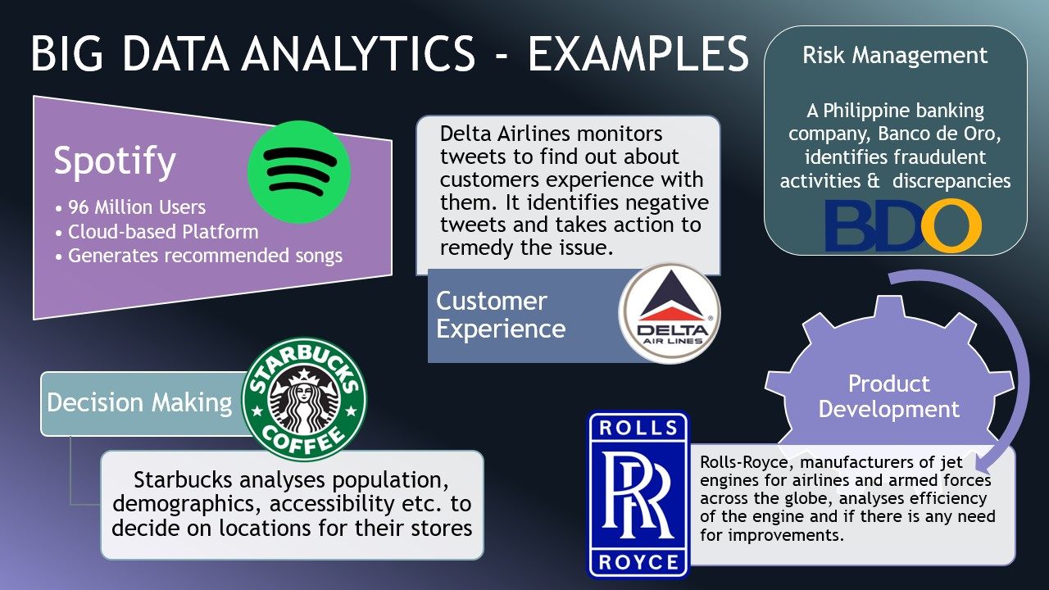

Slide 26
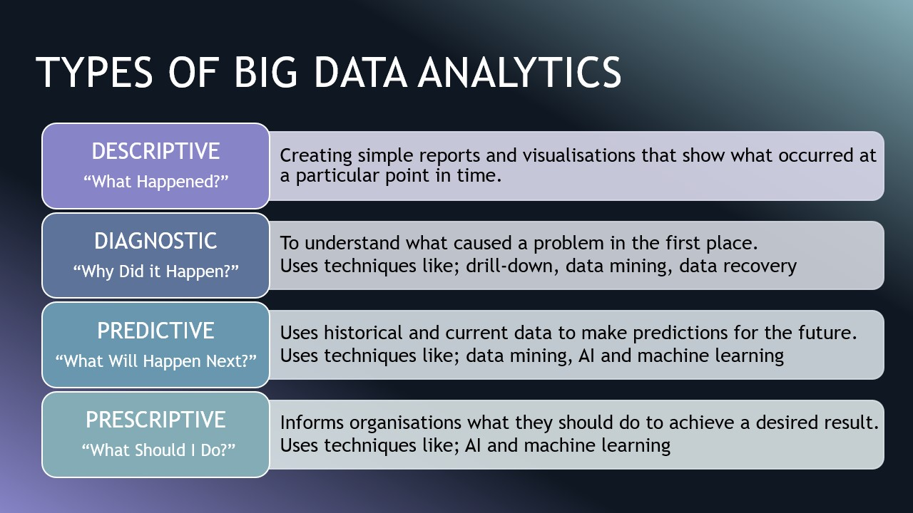

Slide 27
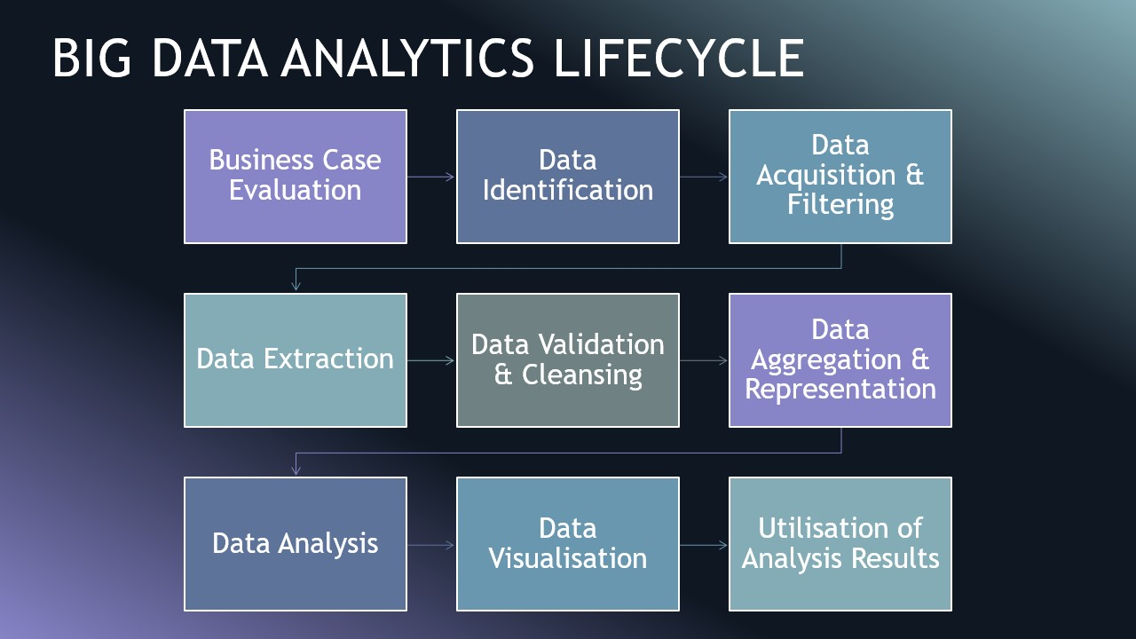

Slide 28
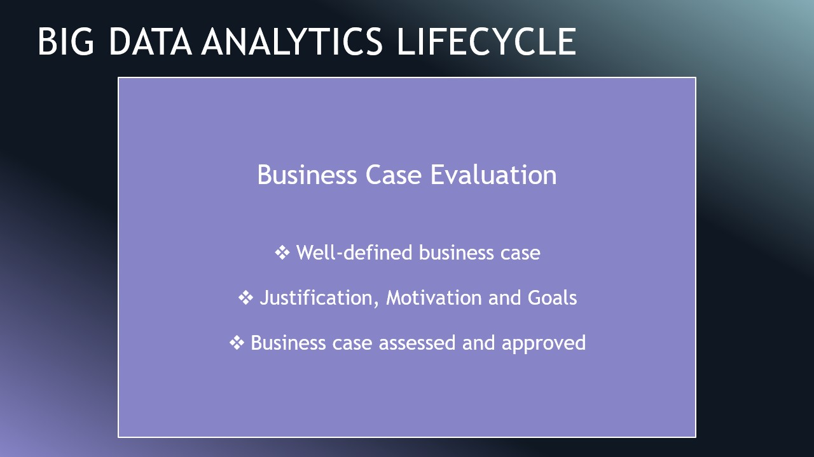

Slide 29
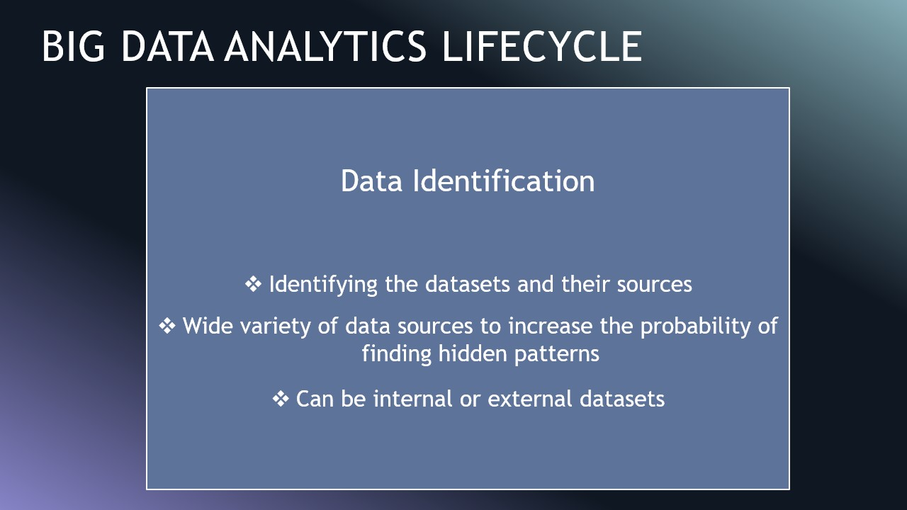

Slide 30
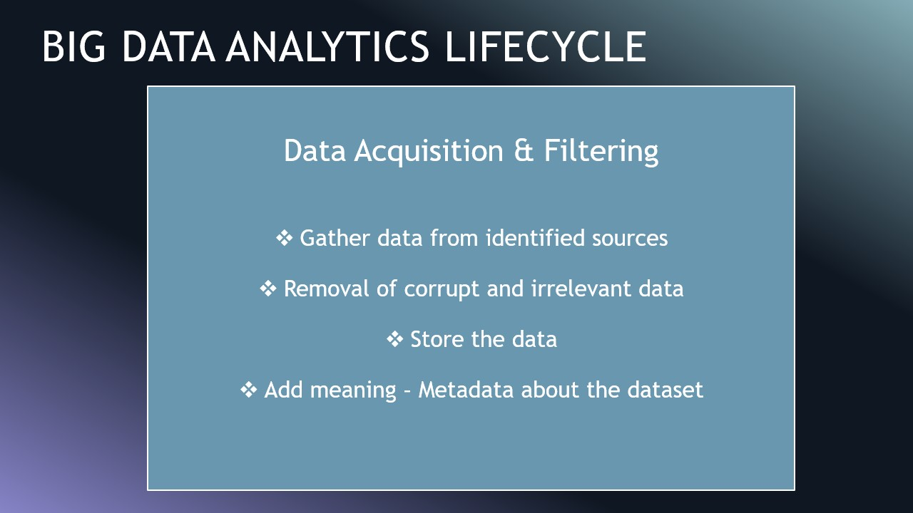

Slide 31
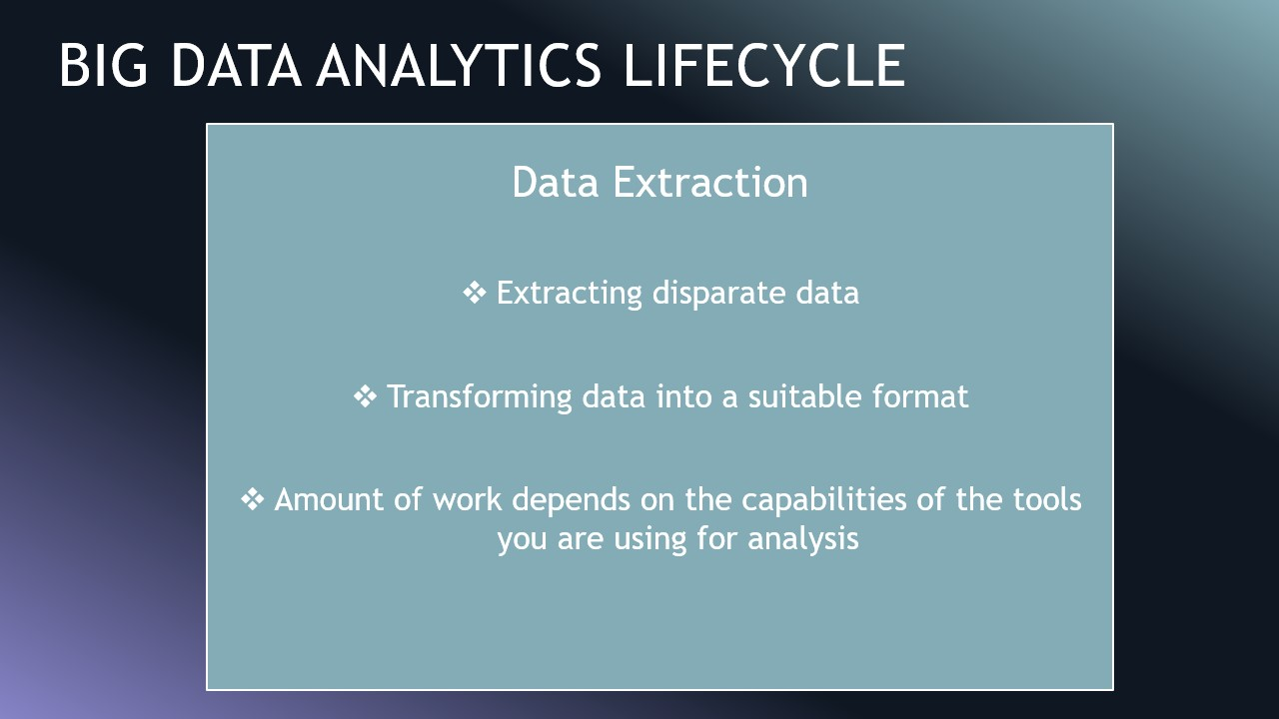

Slide 32
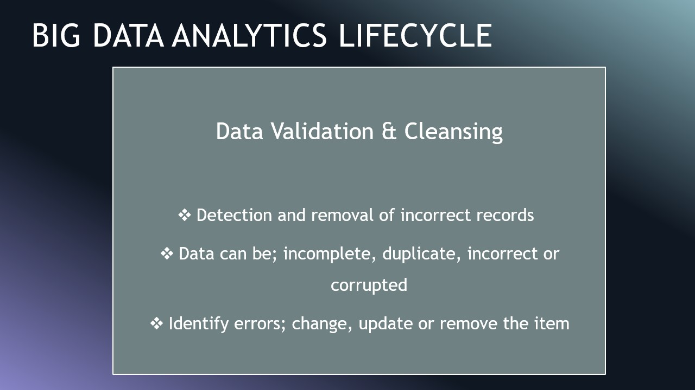

Slide 33
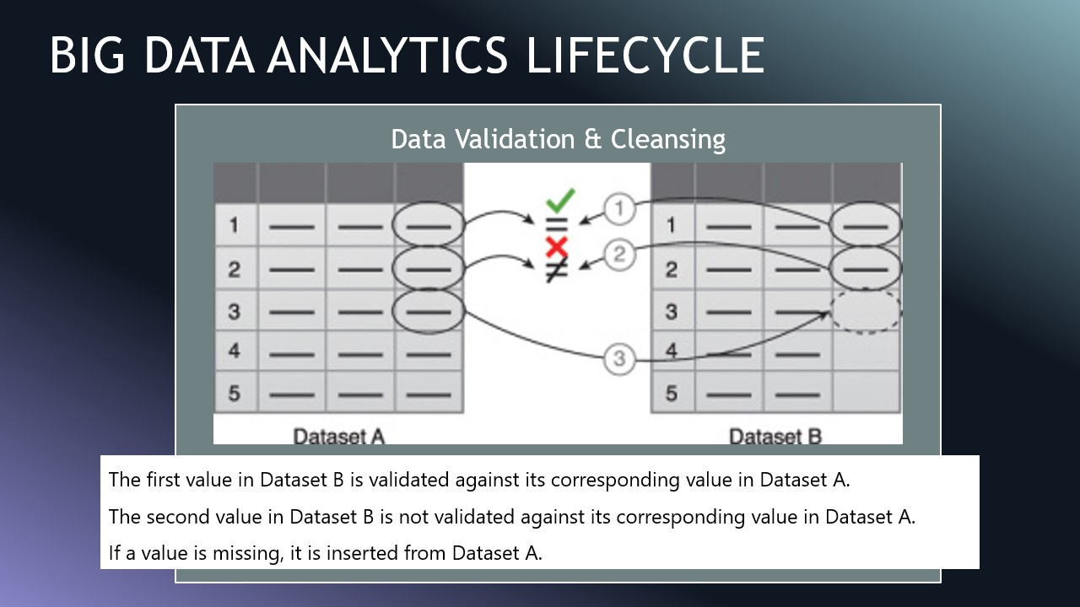

Slide 34
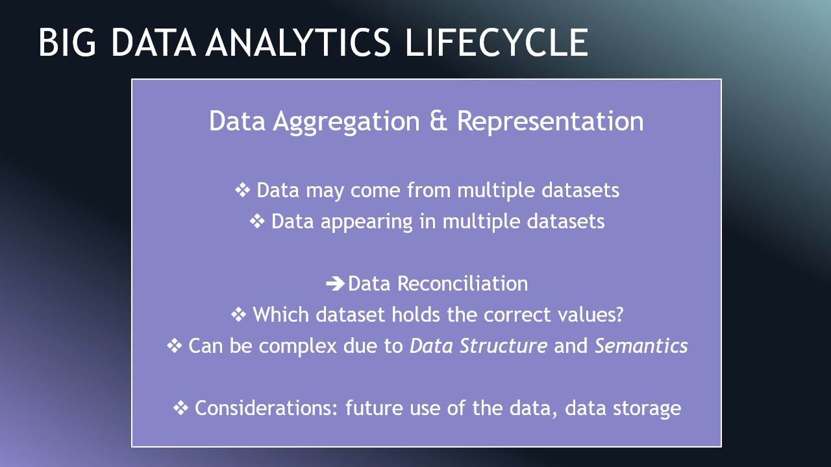

Slide 35
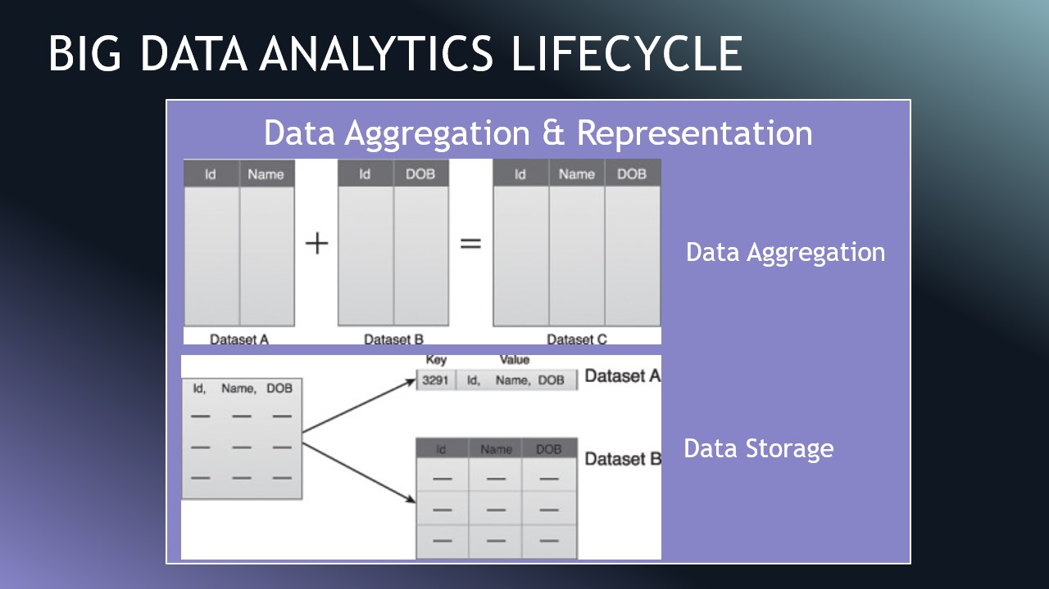

Slide 36
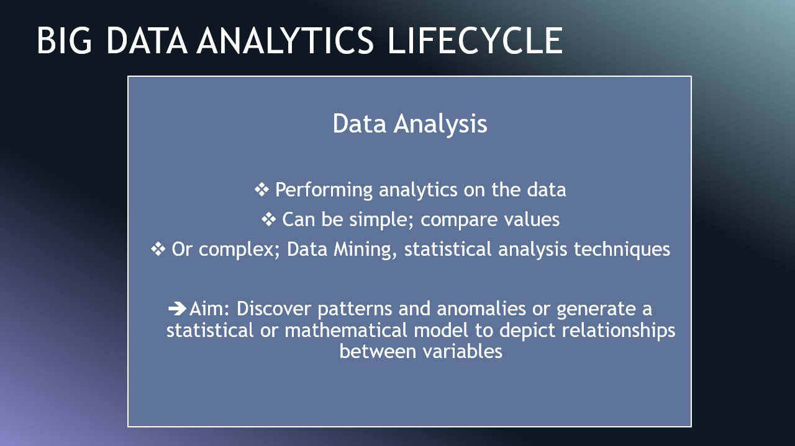

Slide 37
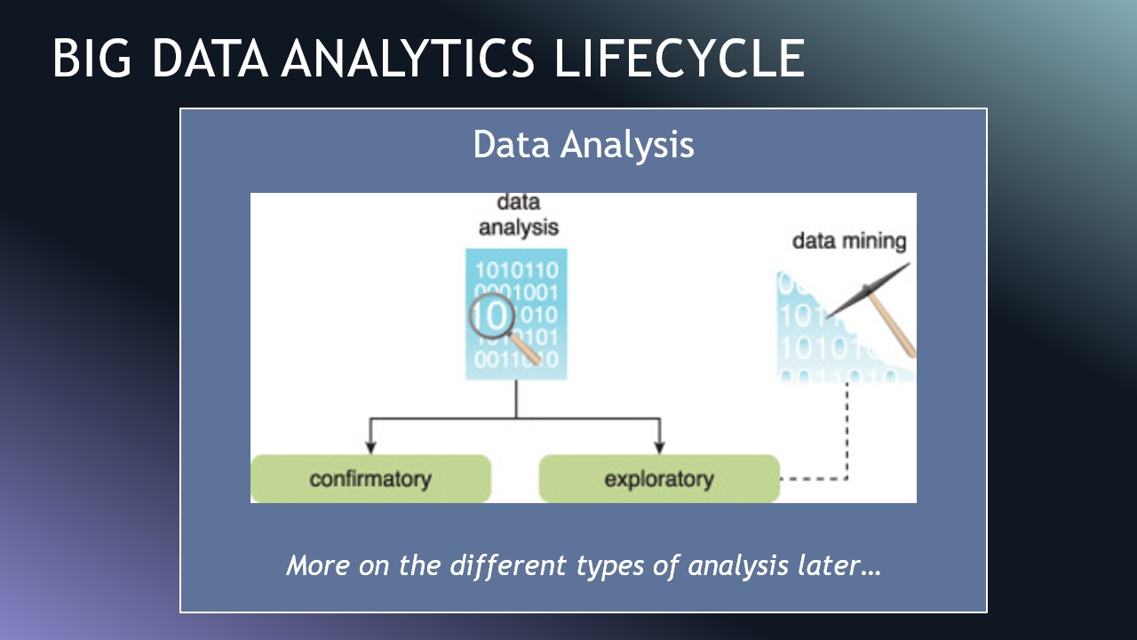

Slide 38
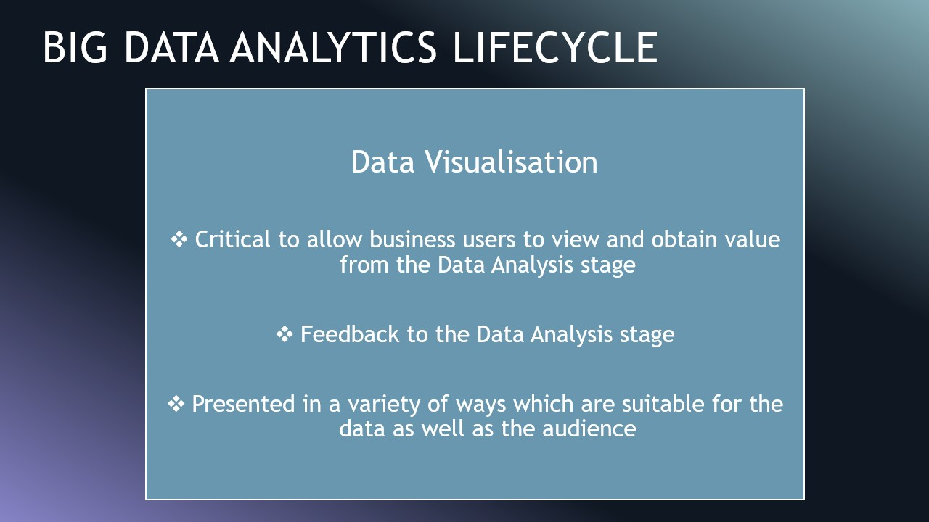

Slide 39
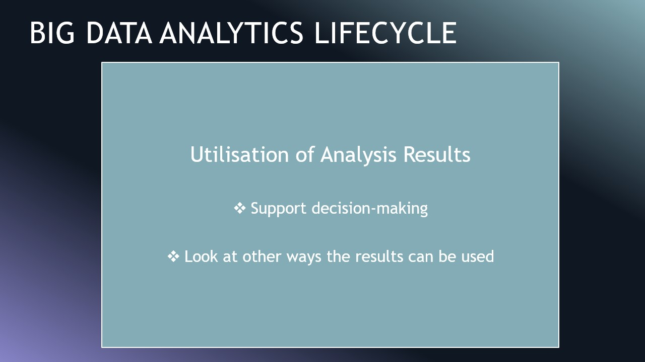

Slide 40
In Summary
The Big Data Analytics Lifecycle includes the following steps:
Business Case Evaluation – define the problem.
Data Identification – select required data.
Data Acquisition & Filtering – collect and filter data.
Data Extraction – extract useful information.
Data Validation & Cleansing – clean and correct data.
Data Aggregation & Representation – combine and structure data.
Data Analysis – apply analytics methods to find insights.
Data Visualisation – present results visually.
Utilisation of Analysis Results – use insights for decision-making.

Slide 41
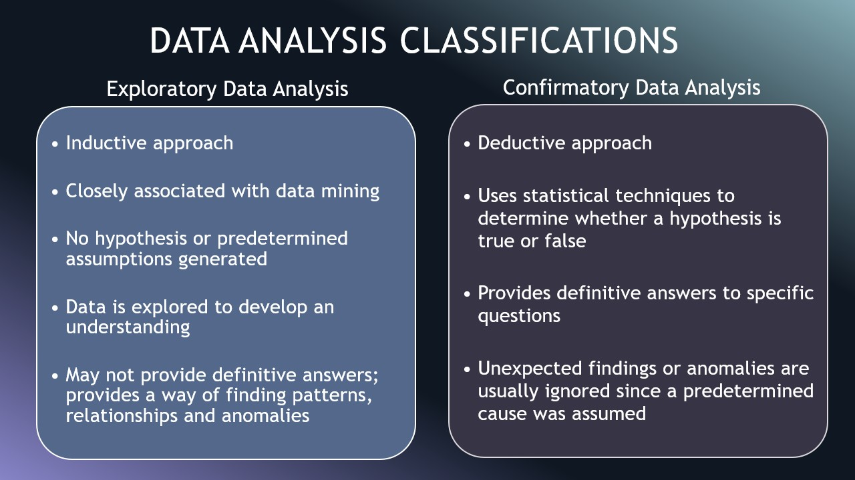

Slide 42
Data Analysis Classification
Exploratory Data Analysis (EDA) : Analogy
EDA is like being a detective exploring a new city you don't know exactly what you'll find, but you're looking for clues and patterns.
Inductive approach. As it start with the data and observe patterns to form theories or hypotheses.
To explore the data to develop an initial understanding, find patterns, relationships, and anomalies.
The goal is to generate potential hypotheses from the data.

Slide 43
Data Analysis Classification
Confirmatory Data Analysis (CDA) : Analogy
CDA is like a courtroom trial → you have a specific hypothesis (the charge) and you use evidence (data) and formal rules (statistics) to determine if it is true or false.
Deductive approach. You start with a theory or hypothesis and use data to test its validity.
To use statistical techniques to determine whether a hypothesis is true or false (e.g, hypothesis testing).

Slide 44
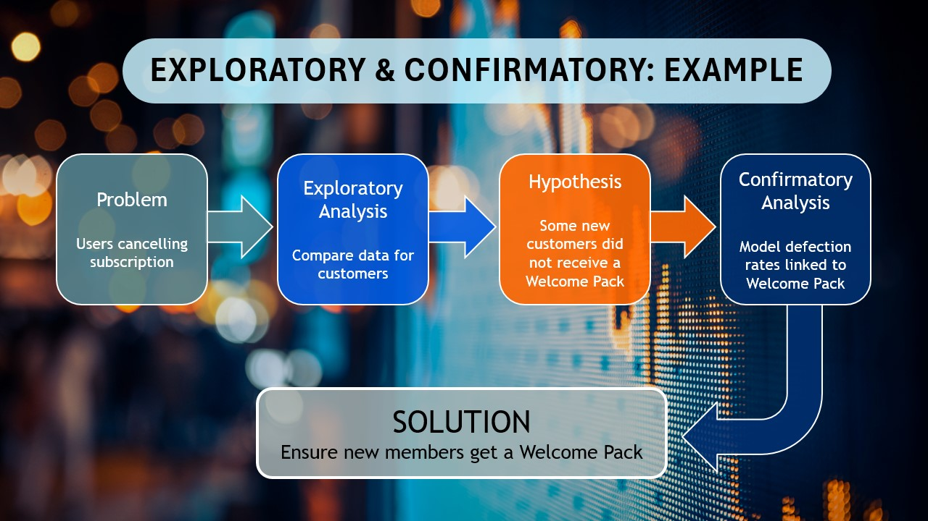

Slide 45
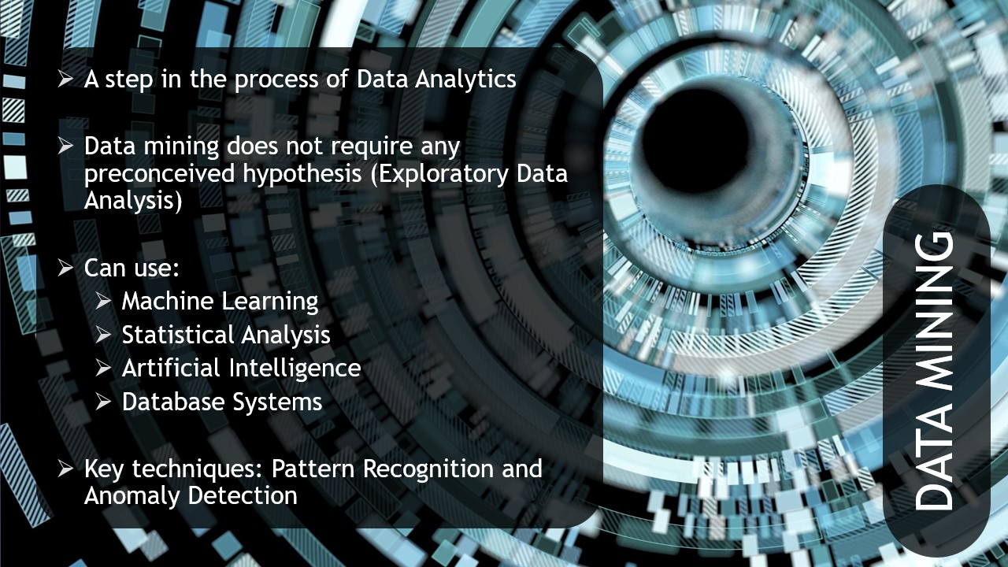

Slide 46
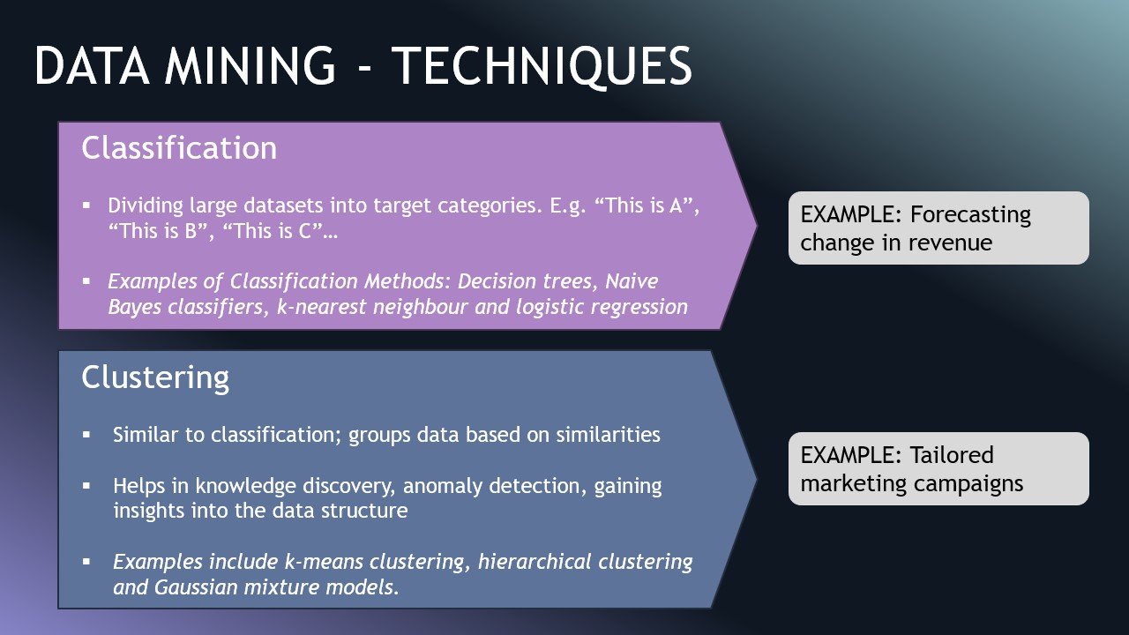

Slide 47
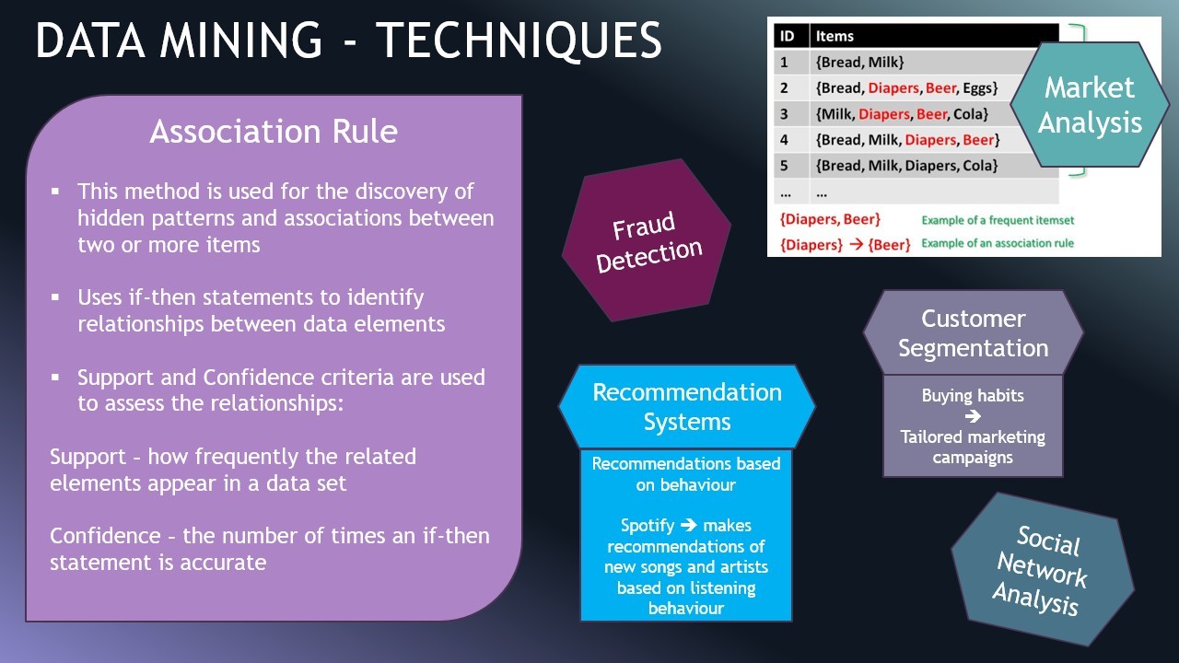

Slide 48
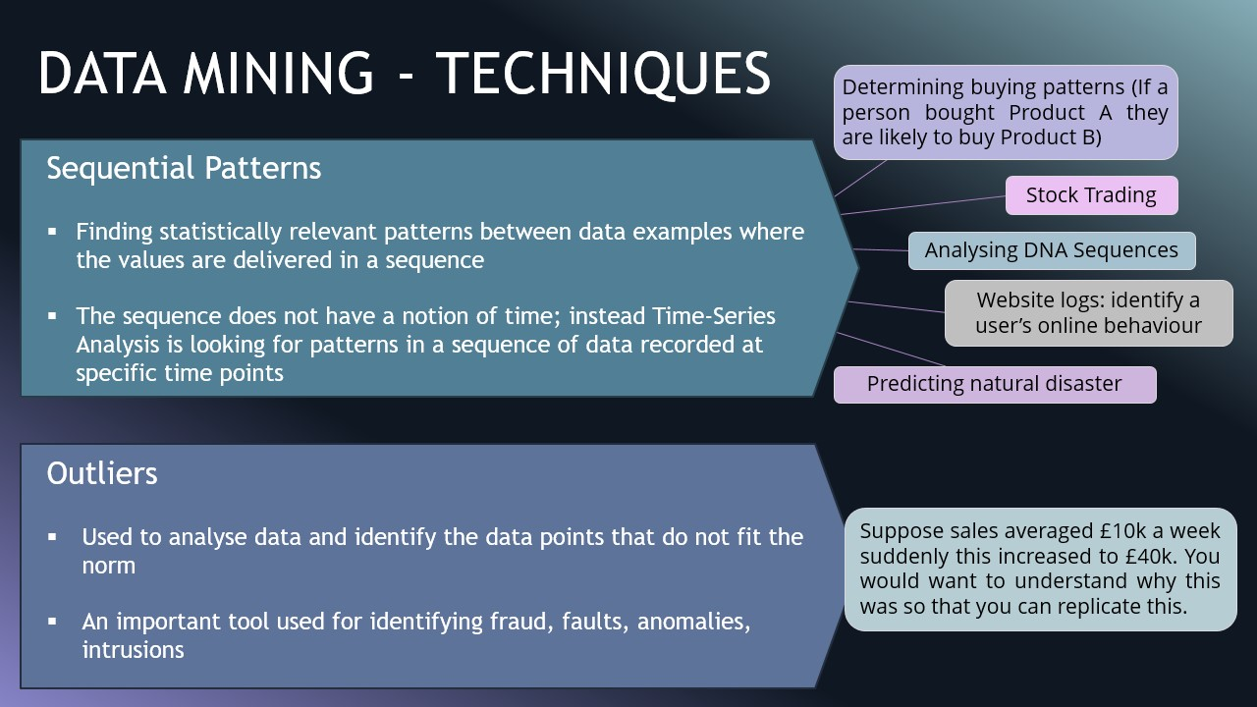

Slide 49
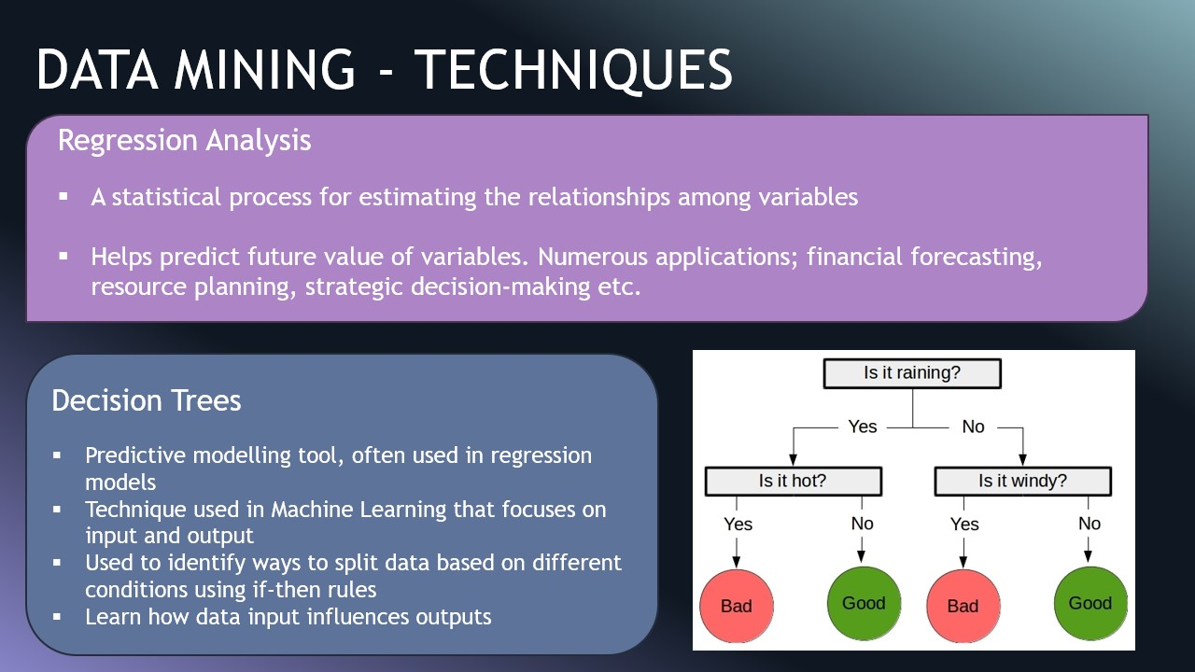

Slide 50
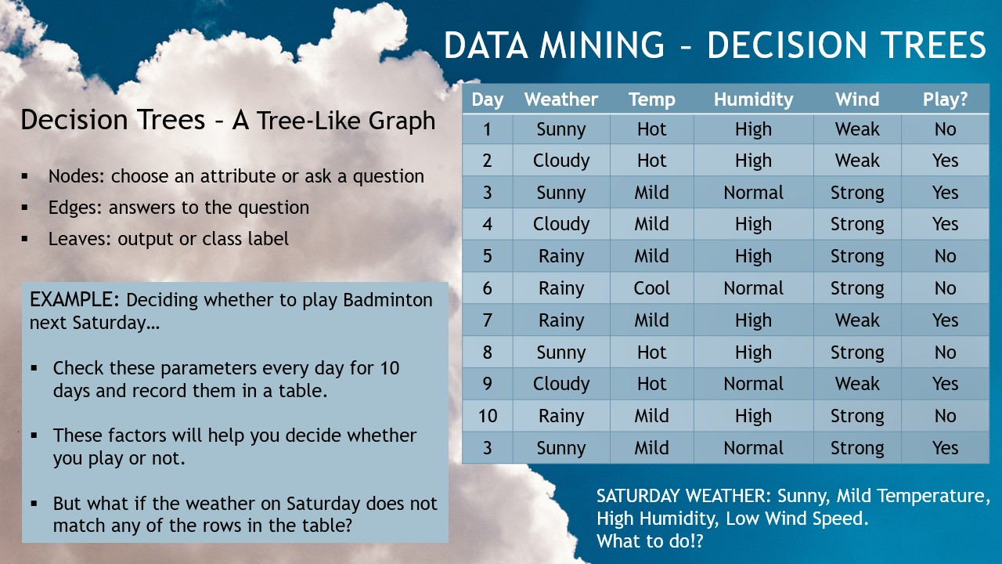

Slide 51
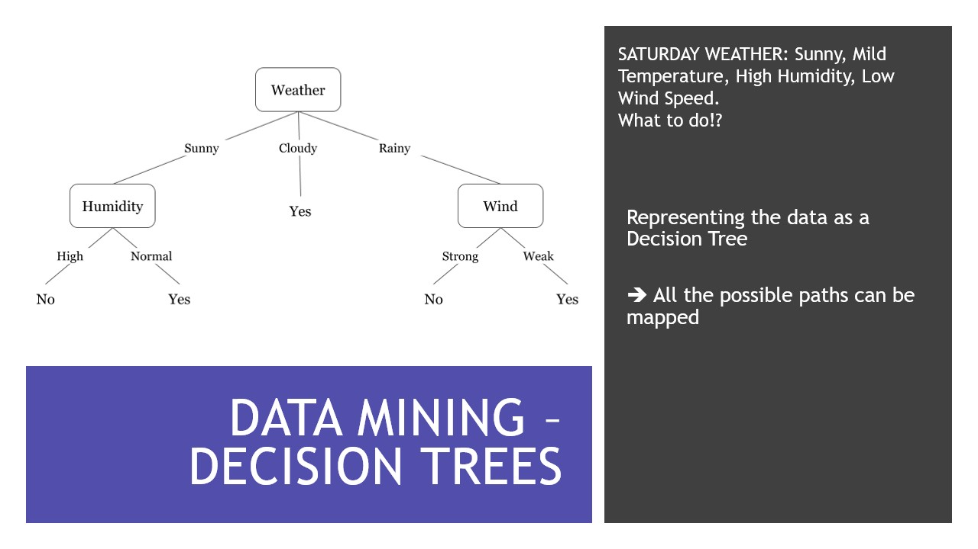

Slide 52
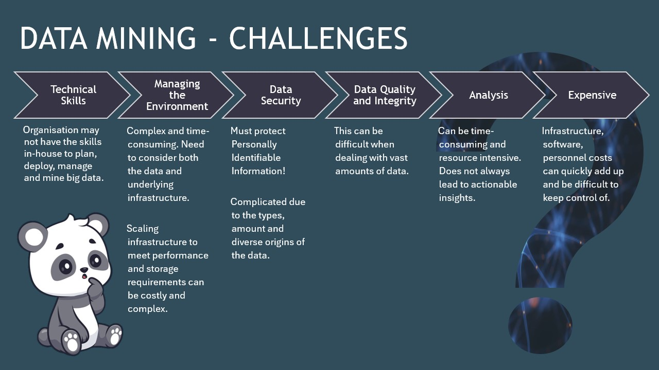

Slide 53
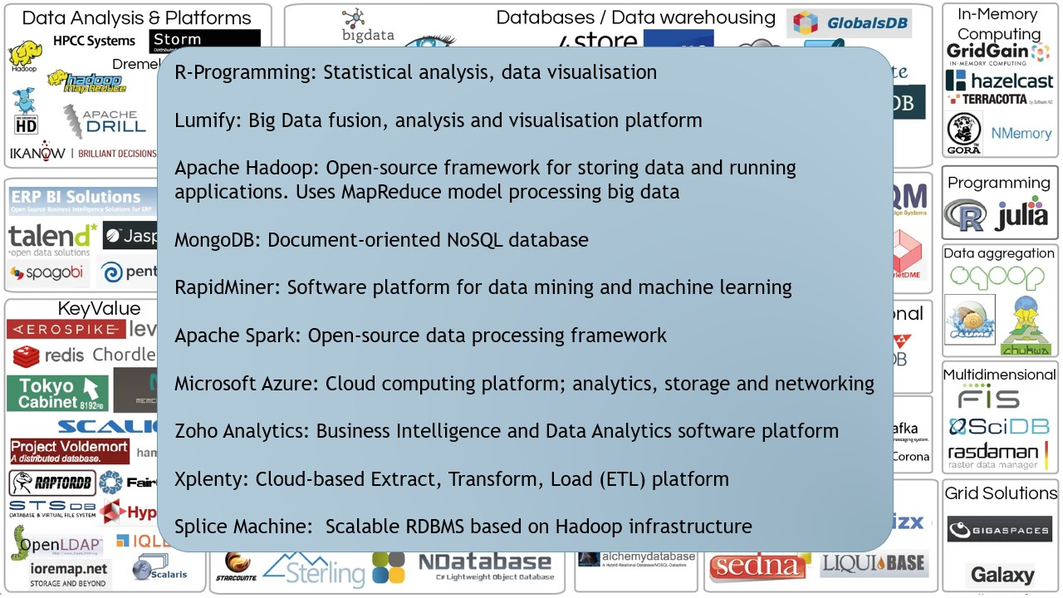

Slide 54
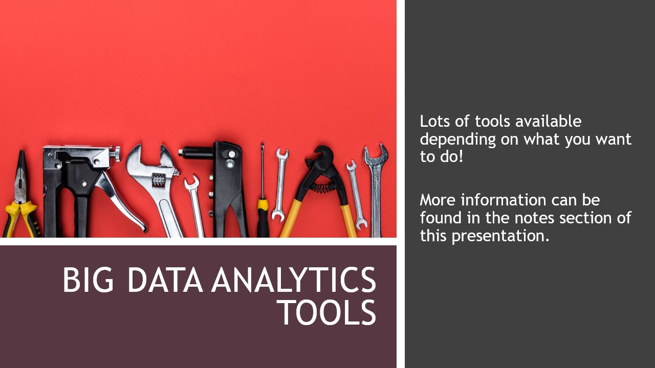

Slide 55
